Slide 1
WELCOME MVUSD's DELAC Meeting
September 22nd 2021
Jill Buschhausen
jbuschhausen@murrieta.k12.ca.us
Notes:
Languages included are:
Spanish
Chinese (Simplified)
Filipino
Vietnamese
Arabic

Slide 2
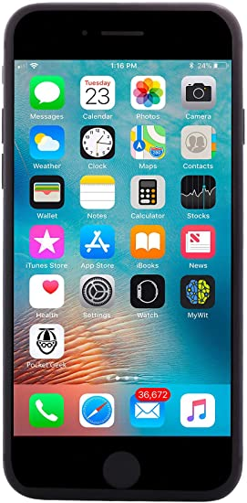
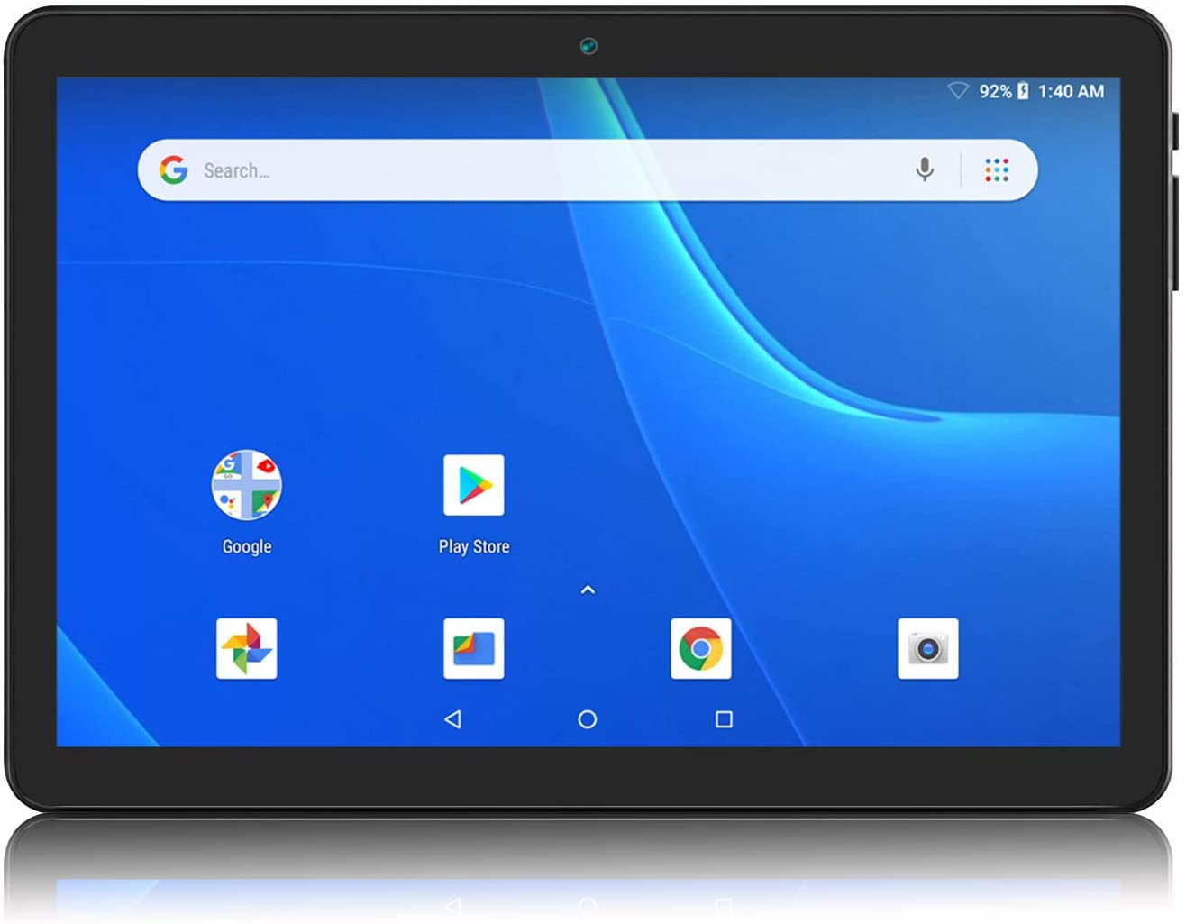
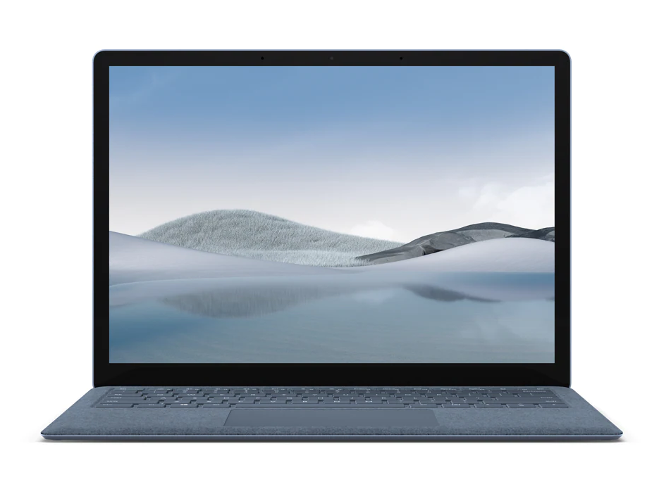
URL Address
QR Code
If you need audio translation, on the next screen scan the QR code or enter the URL address into a web browser
Kung kailangan mo ng audio pagsasalin, sa susunod na screen i-scan ang QR code o ipasok ang URL address sa web browser
Si necesita traducción de audio, en la siguiente pantalla escanee el código QR o ingrese la dirección URL en un navegador web
Nếu bạn cần dịch âm thanh, trên màn hình tiếp theo quét mã QR hoặc nhập địa chỉ URL vào trình duyệt web
如果您需要音频翻译，请在下一个屏幕上扫描 QR 代码或将 URL 地址输入 Web 浏览器
إذا كنت بحاجة إلى ترجمة صوتية، قم على الشاشة التالية بمسح رمز الاستجابة السريعة أو أدخل عنوان URL في مستعرض ويب

Slide 3
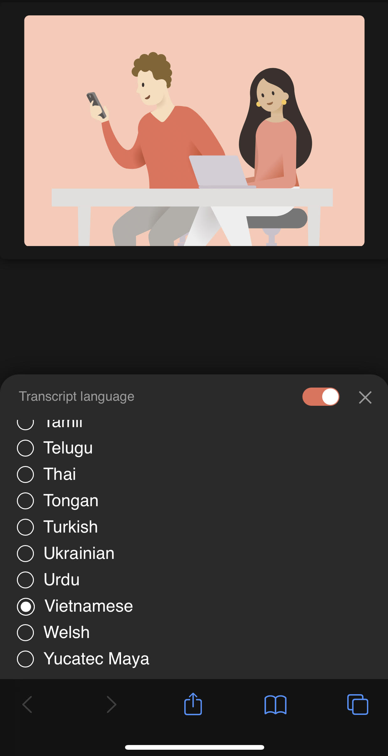
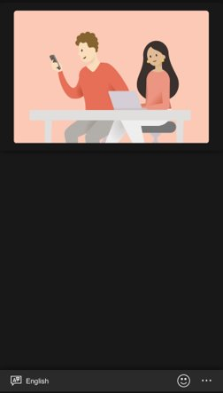
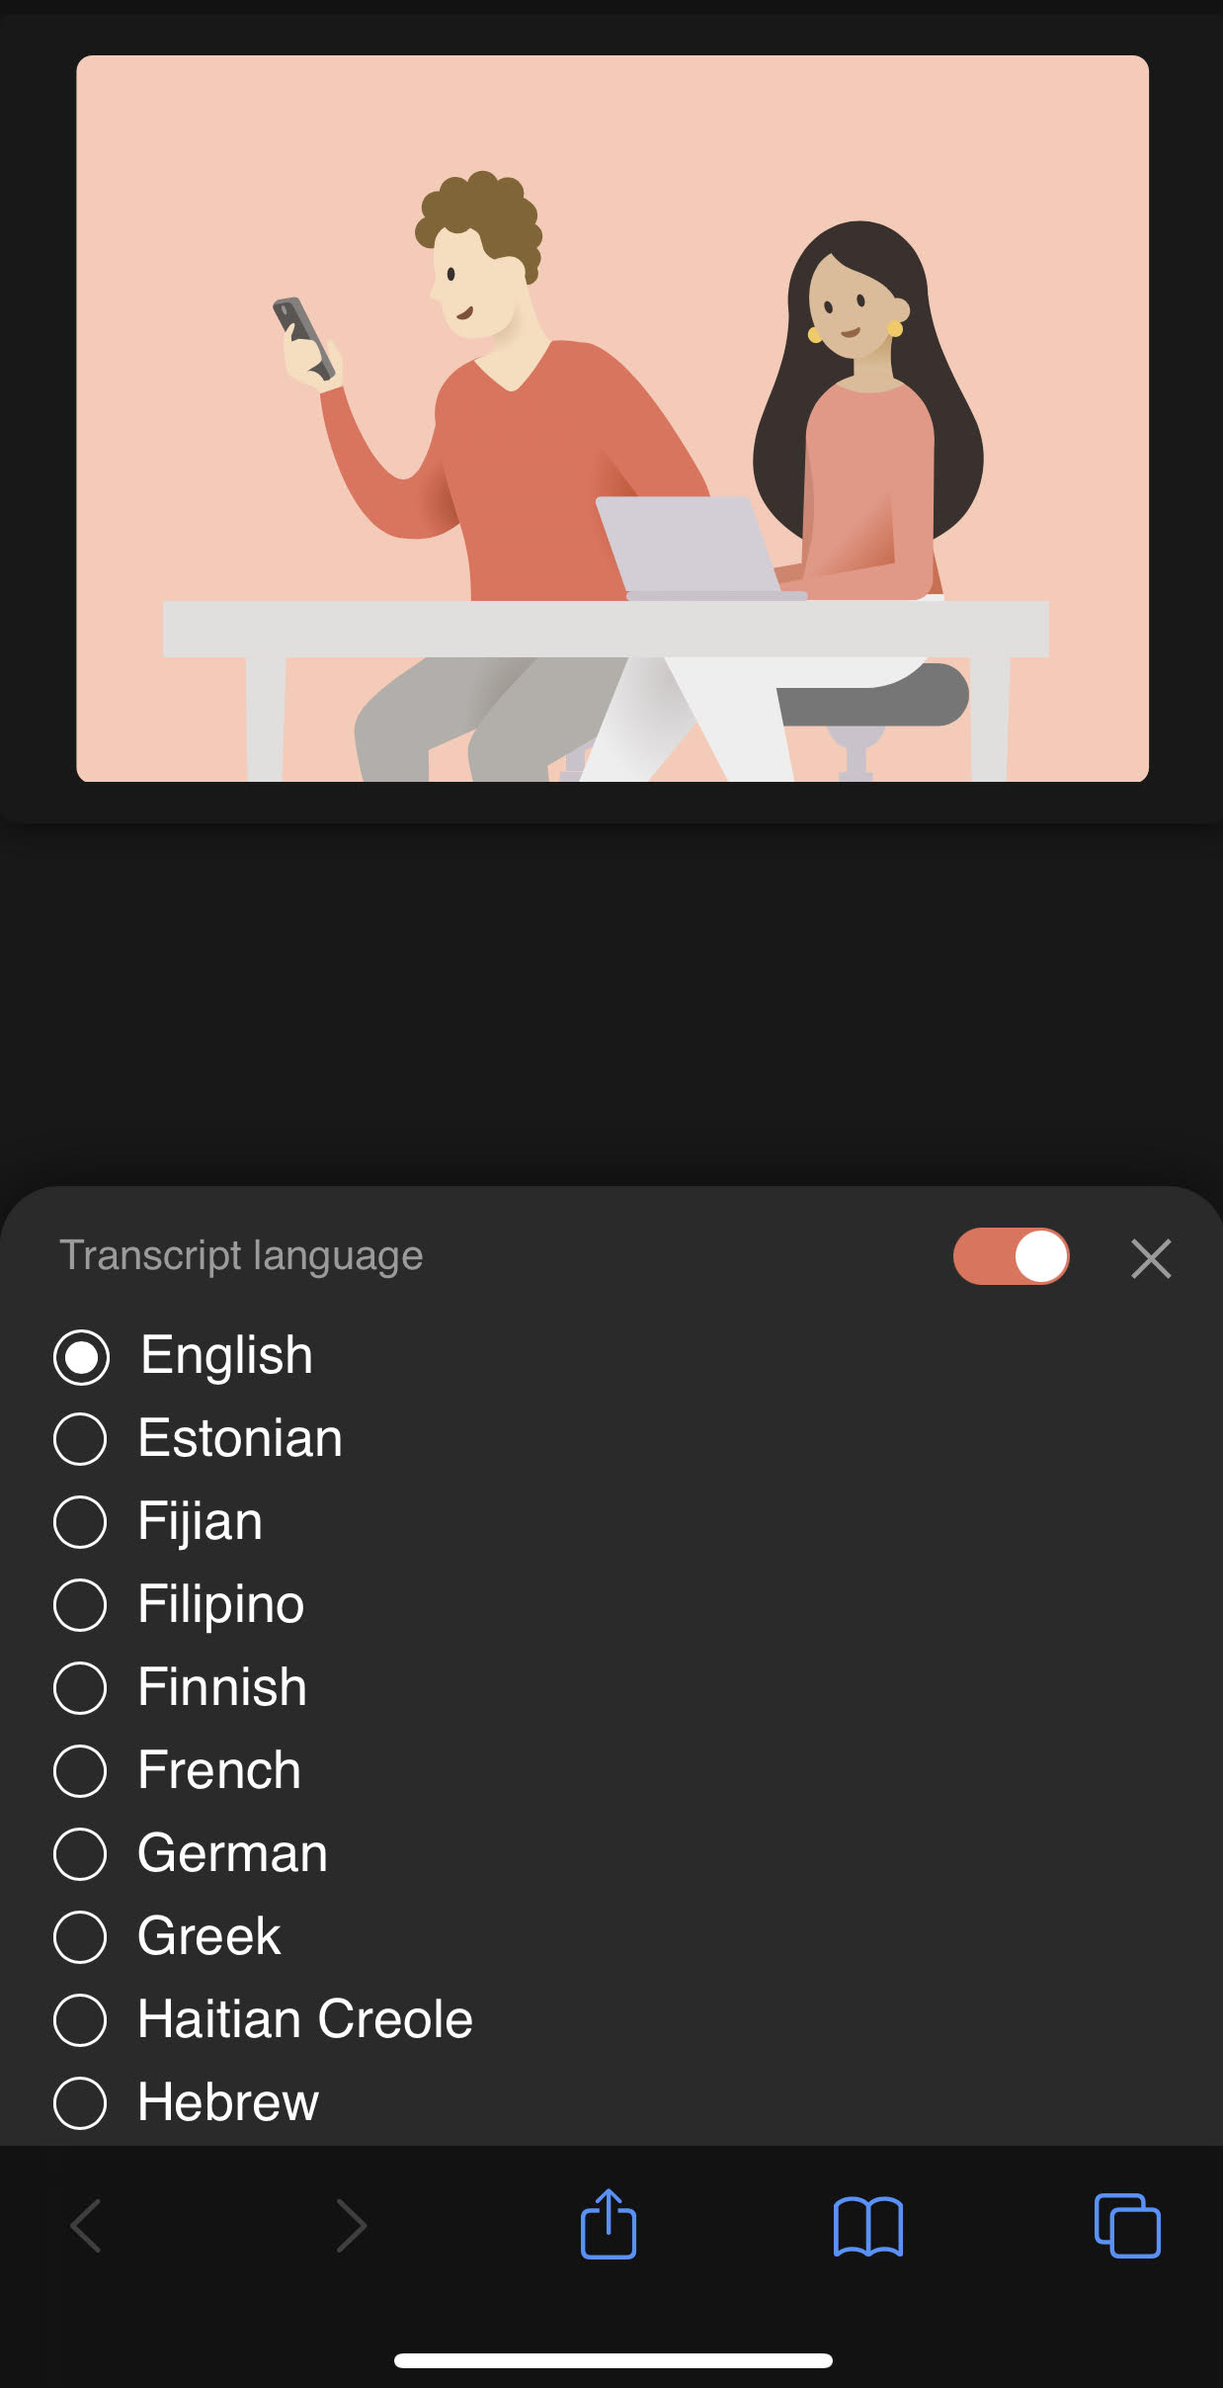
Choose your preferred language from the list
从列表中选择您最喜爱的语言
Elija su idioma preferido de la lista
Chọn ngôn ngữ ưa thích của bạn từ danh sách
Piliin ang iyong ginustong wika mula sa listahan
اختر لغتك المفضلة من القائمة
Notes:
Coose your preferred language from the list

Slide 4
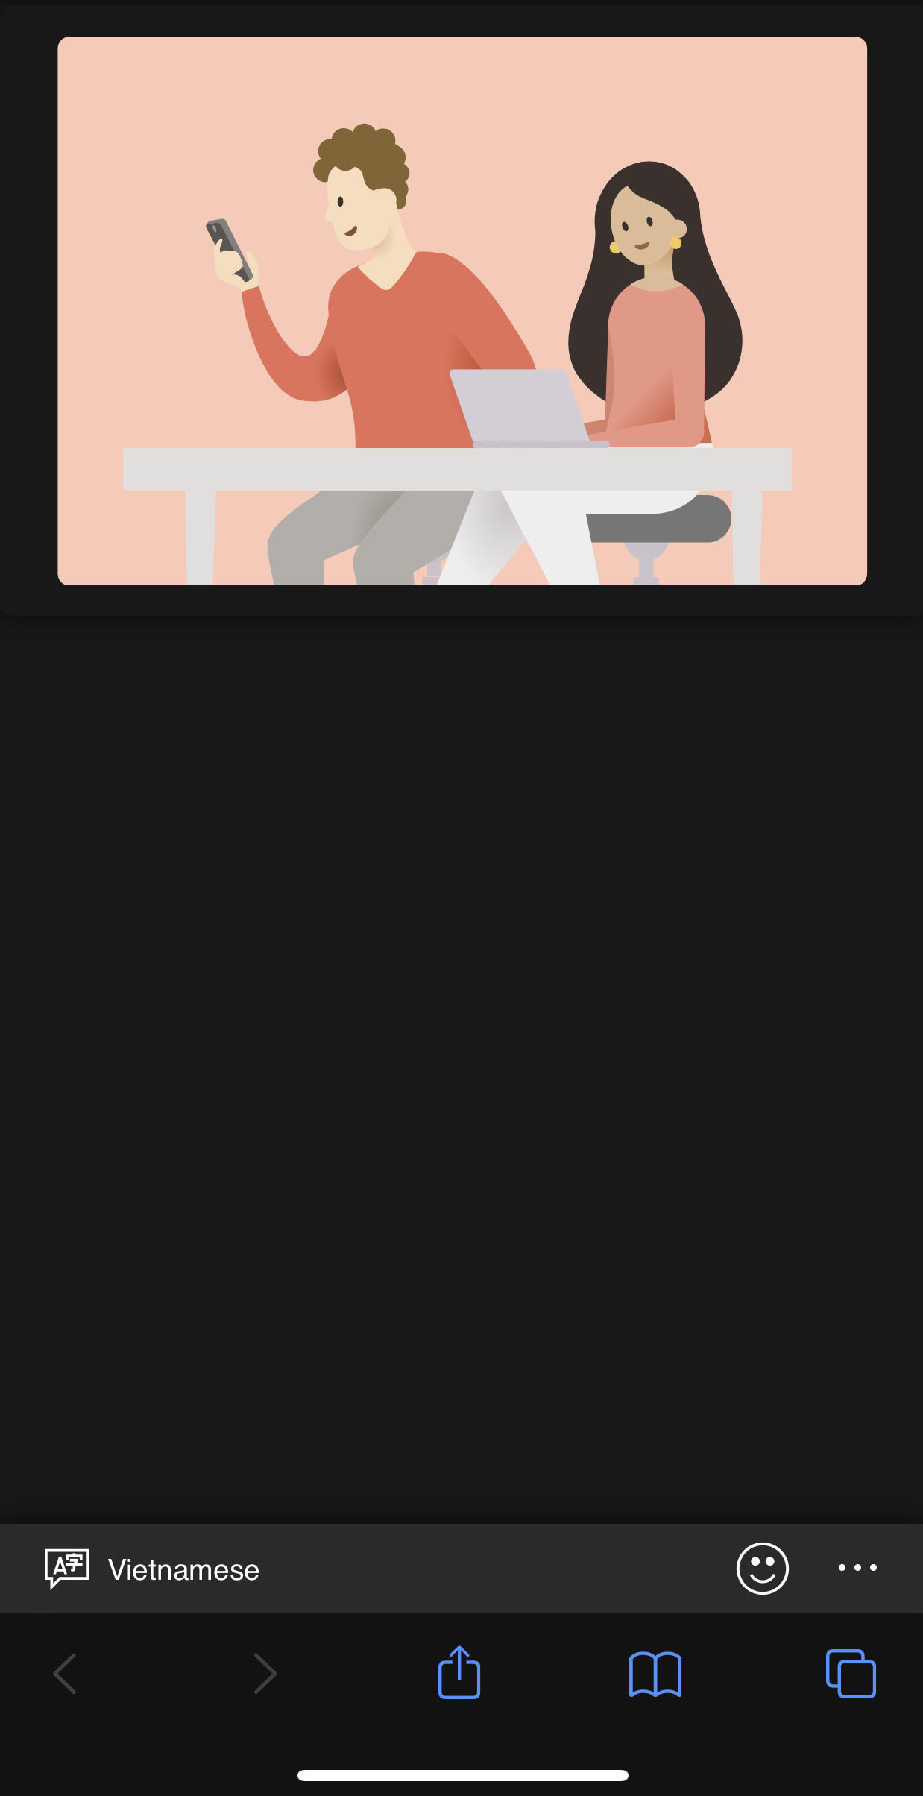
Your chosen language will be displayed in the lower corner. All audio will be automatically translated for you on your device.
El idioma elegido se mostrará en la esquina inferior izquierda. Todo lo dicho se traducirá automáticamente para usted en su dispositivo.
您选择的语言将显示在下角。所有音频将在您的设备上自动为您翻译。
Ang pinili mong wika ay ididispley sa mas mababang sulok. Lahat ng audio ay awtomatikong isasalin para sa iyo sa iyong device.
Ngôn ngữ bạn chọn dưới đây sẽ hiển thị góc dưới bên trái. Tất cả những gì đã nói sẽ được tự động dịch cho bạn trên thiết bị của bạn.
سيتم عرض اللغة التي اخترتها في الزاوية السفلى. سيتم ترجمة جميع الأصوات تلقائيا لك على جهازك.
Notes:
The language you chose will show in the bottom left corner. Everything that is said will be translated automatically on your device.

Slide 5
Welcome to 2021-22 DELAC District English Learner Advisory Council September 22, 2021
Stakeholder Engagement
Annual Notification
Student Score Report
Reclassification
What's Coming

Slide 6
Murrieta Valley Unified School District Stakeholder Feedback Presentation
Notes:
Mary

Slide 7
Expanded Learning Opportunities Grant Plan
Funds are available through September 2023 and September 2024, to meet the needs of students academically, social-emotional, and other supports (meals and snacks) for our unduplicated pupils, students with disabilities, students at-risk or disengaged, and students who are below grade level:
K-3 Smaller Class Sizes
Intervention/Credit Recovery/Expanded Summer School
Tutoring Services
Mental Health/Counseling Services
Special Education Services and Supports
Professional Development
Academic (Accelerated Learning/Learning Gaps/Student Engagement)
Social Emotional Well-Being
Additional Paraprofessional/Instructional Aide Supports
Notes:
Mary

Slide 8
Elementary and Secondary School Emergency Relief (ESSER) III Grant Plan
Funds available through September 2024, to address students’ academic, social-emotional, and mental health needs, as well as any opportunity gaps that existed before, and were worsened by, the COVID-19 pandemic. Additionally, supports to continuously and safely operate school for in-person learning in a way that reduces or prevents the spread of the COVID-19 virus.
PPE, Sanitation, Testing, Contact Tracing, etc.
K-3 Smaller Class Sizes
Intervention K-12/Credit Recovery/Expanded Summer School
Tutoring Services
Mental Health/Counseling Services
Special Education Services and Supports
Technology Hardware and Software
Transportation for After School and Saturday Tutoring
Notes:
Mary

Slide 9
Feedback through Padlet
What do you see as the greatest student needs this school year?
What feedback do you have about the areas we have identified for the grants?
Do you have any additional items that support student learning to consider as we develop the grant plans?
Notes:
Faythe

Slide 10
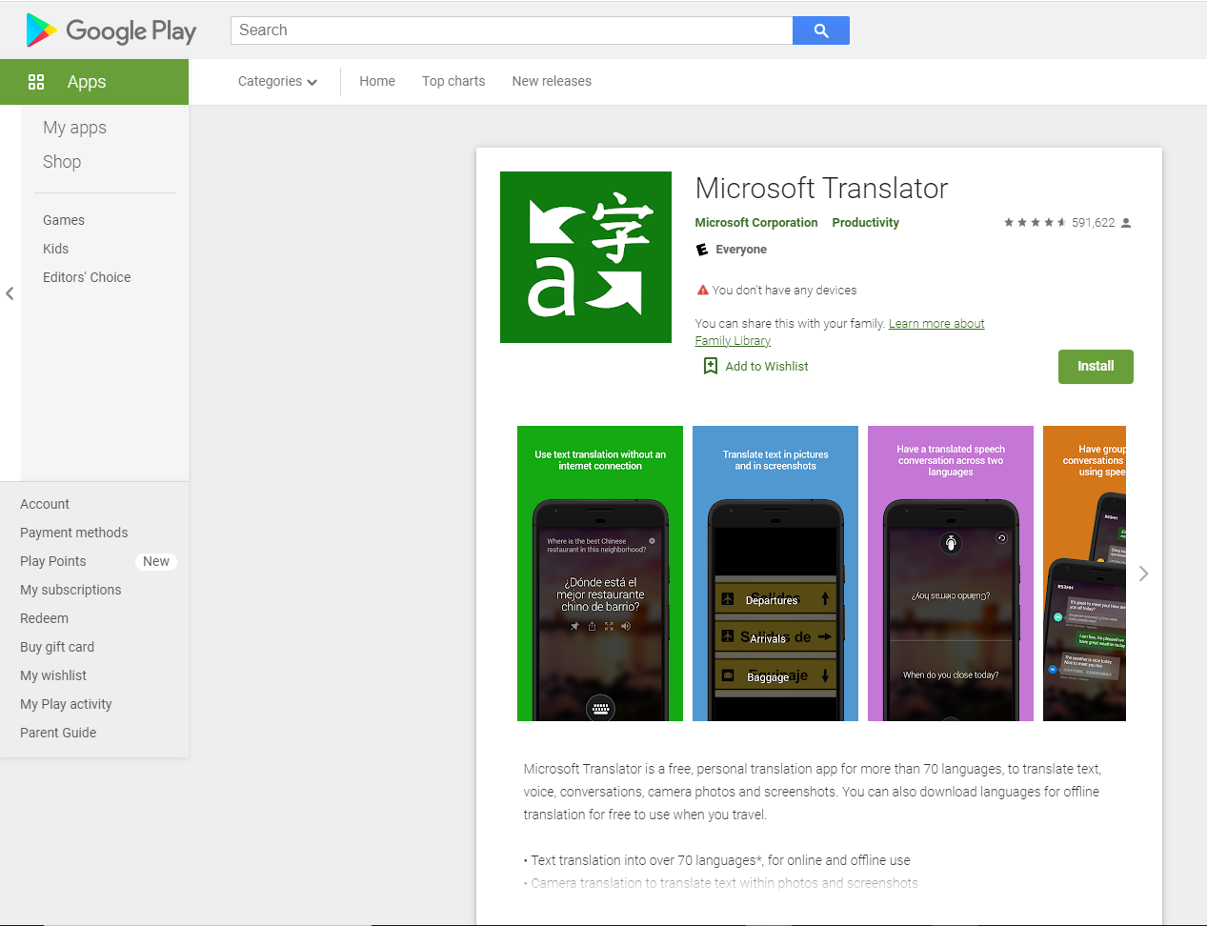
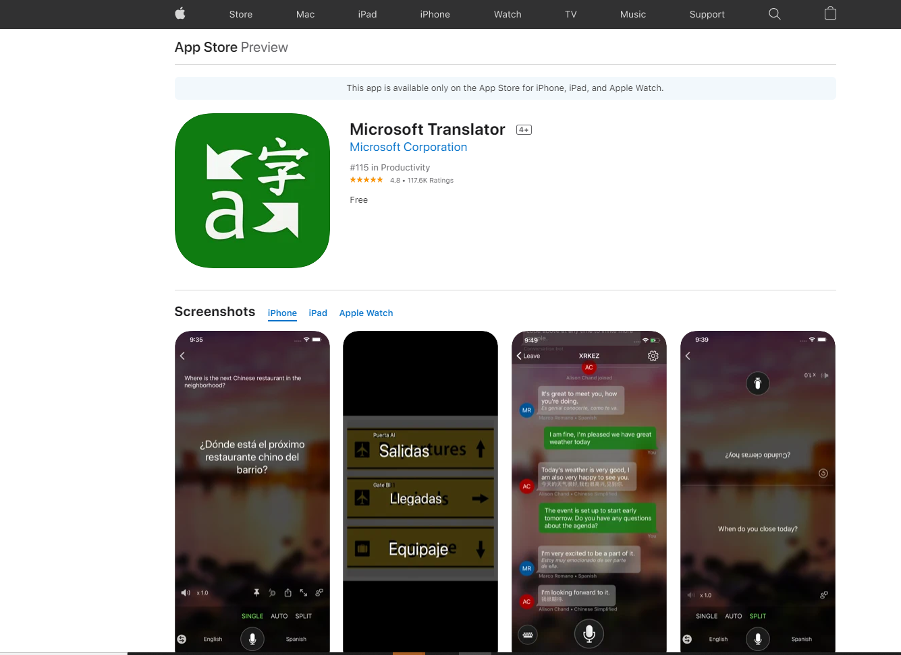
Microsoft Tranlsator App
Go to your app store and search "Microsoft Translator" to find app and download for free.

Slide 11
Microsoft Translator - Conversation
Open app and click on image.
Enter code given to you by room facilitator.
Choose language you will be speaking in.
Hold down microphone when you speak so it can be translated for others in the room.
Buksan ang app at i-click sa imahe.
Ipasok ang code na ibinigay sa iyo ng facilitator sa kuwarto.
Pumili ng wikang sasabihin mo.
Pigilan ang mikropono kapag nagsasalita ka para masalin ito para sa iba sa silid.
Mở ứng dụng và nhấp vào hình ảnh.
Nhập mã được cung cấp cho bạn bởi người hướng dẫn phòng.
Chọn ngôn ngữ bạn sẽ nói.
Giữ micro khi bạn nói để nó có thể được dịch cho những người khác trong phòng.
افتح التطبيق وانقر على الصورة.
أدخل الرمز الذي أعطاه لك ميسر الغرفة.
اختر اللغة التي ستتحدث بها.
اضغط باستمرار على الميكروفون عند التحدث حتى يمكن ترجمته للآخرين في الغرفة.
Abra la aplicación y haga clic en la imagen. Ingrese el código que le dio el facilitador de la sala. Elija el idioma en el que hablará. Mantenga presionado el micrófono cuando hable para que pueda traducirse para otras personas en la habitación.
打开应用并单击图像。
输入由客房主持人提供给你的代码。
选择您将要使用的语言。
说话时按住麦克风，以便可以翻译给房间里的其他人。

Slide 12
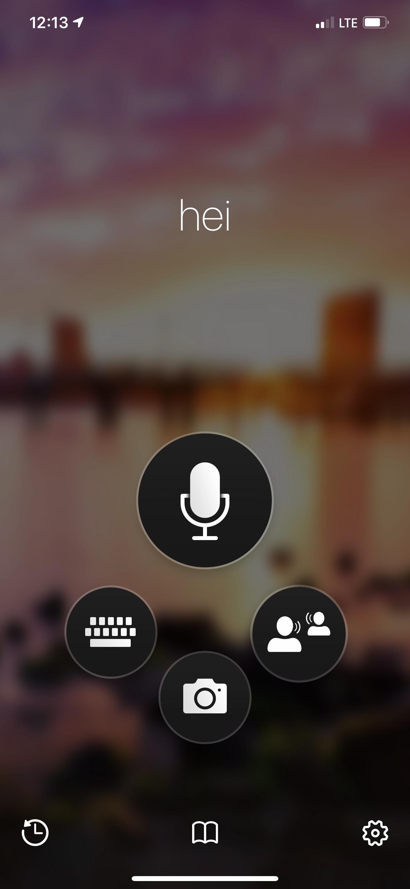
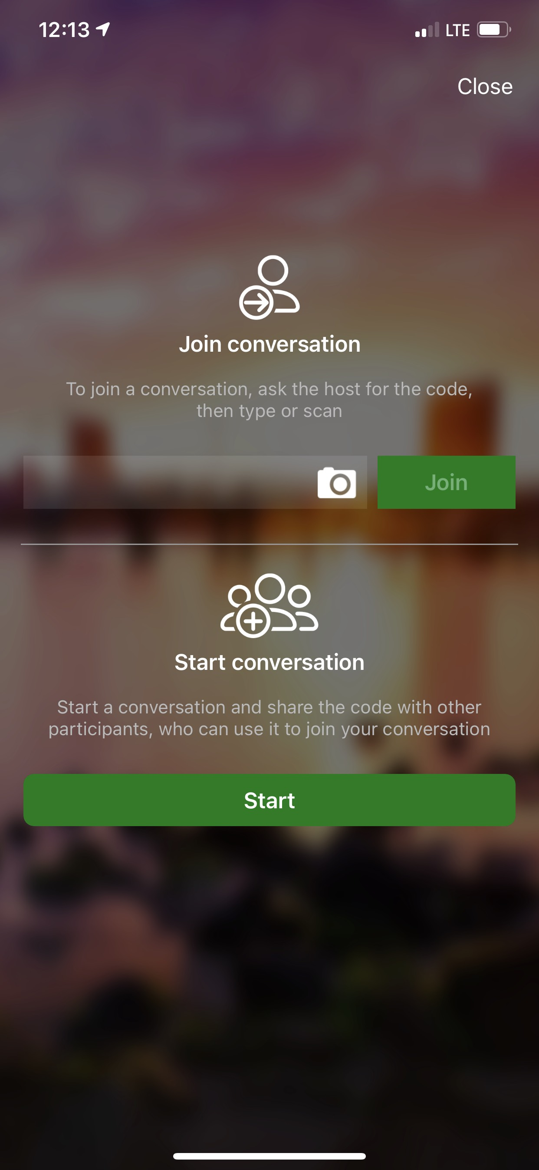
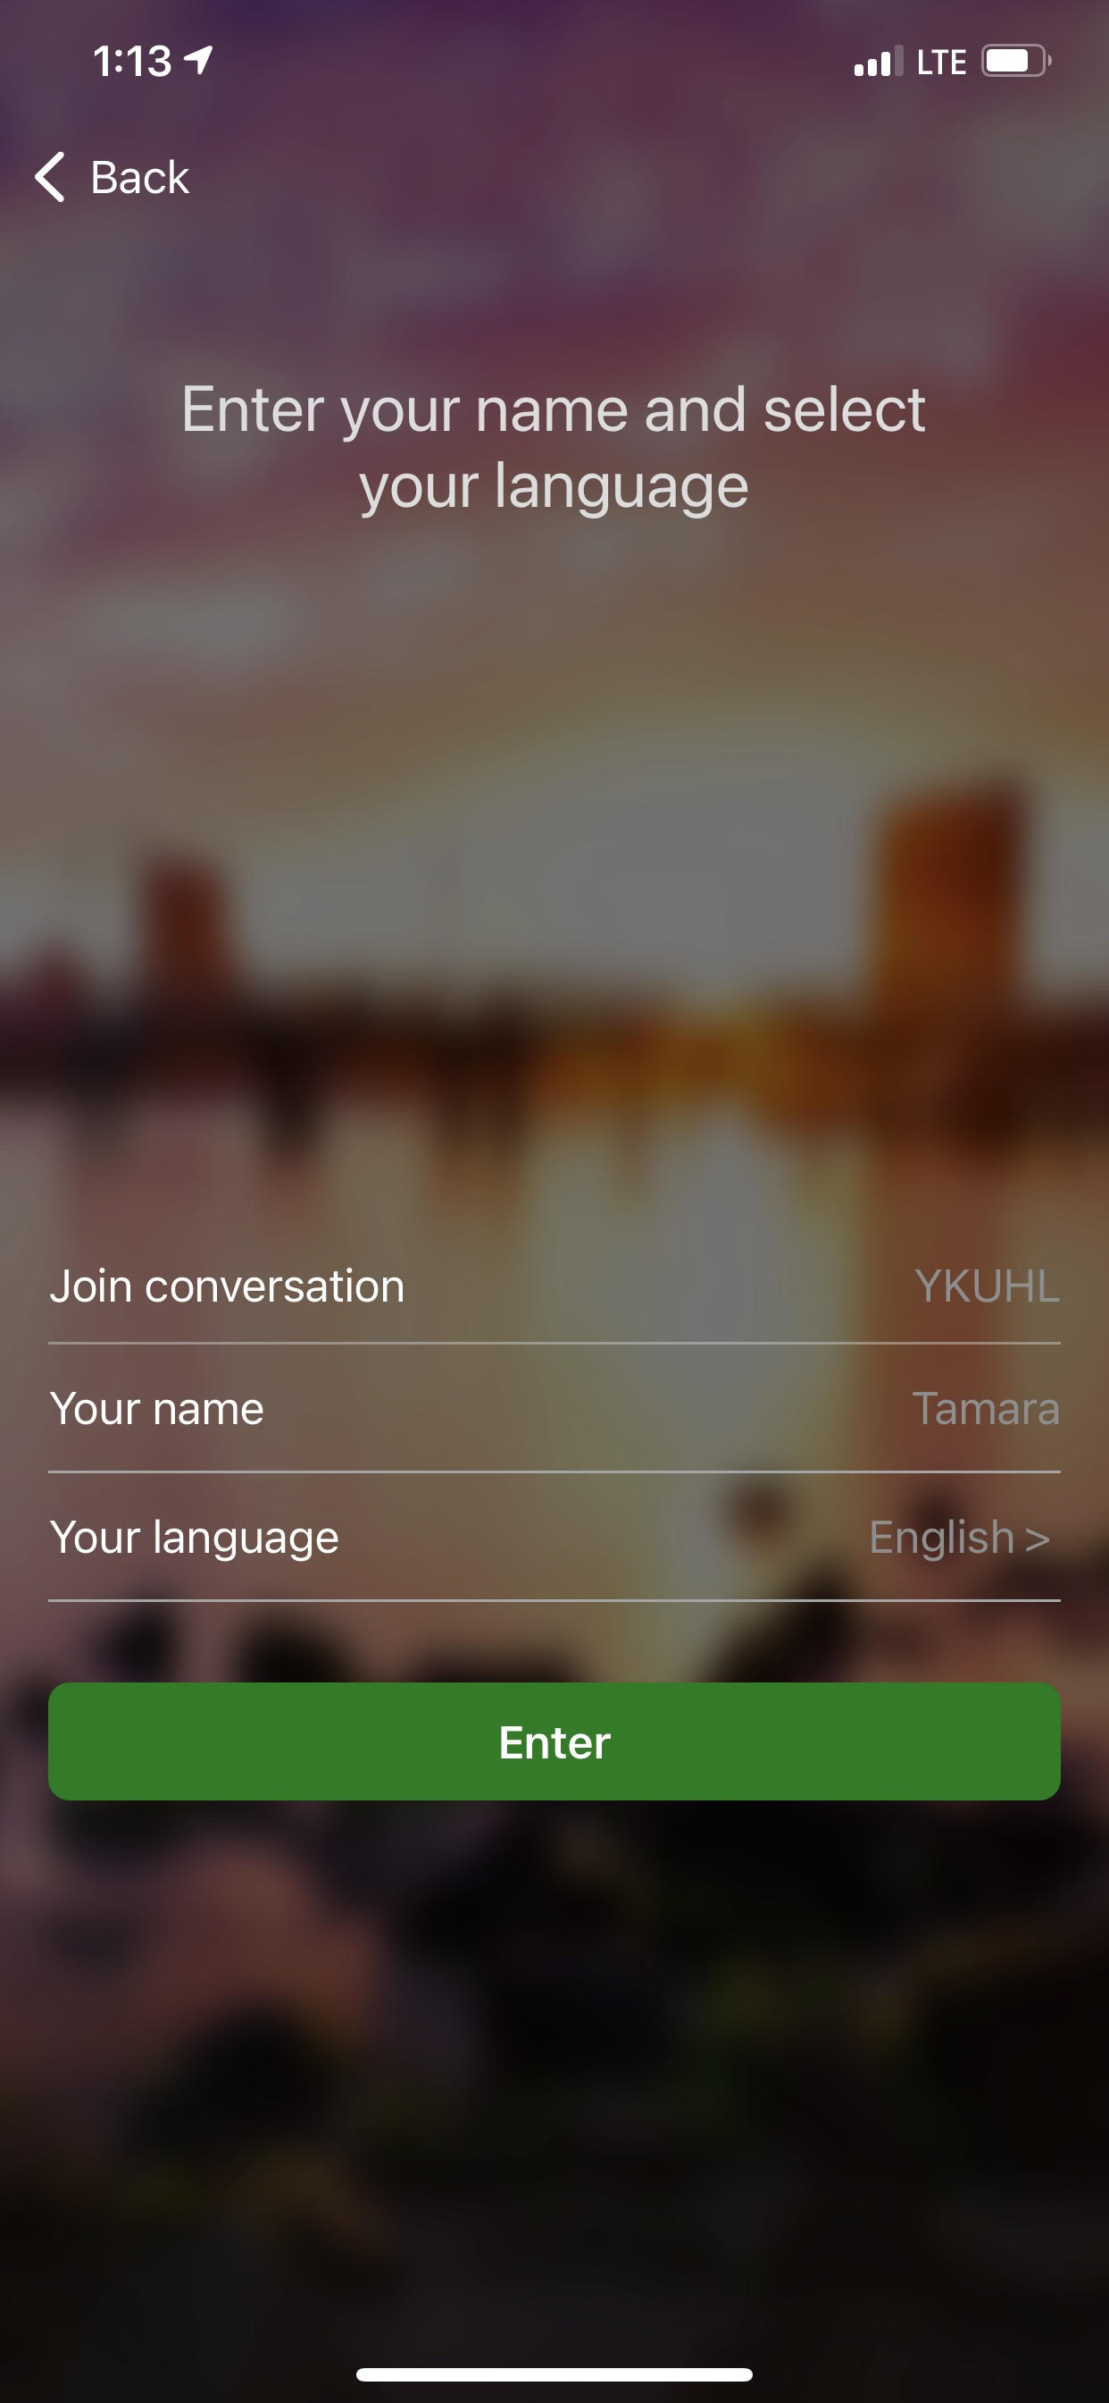
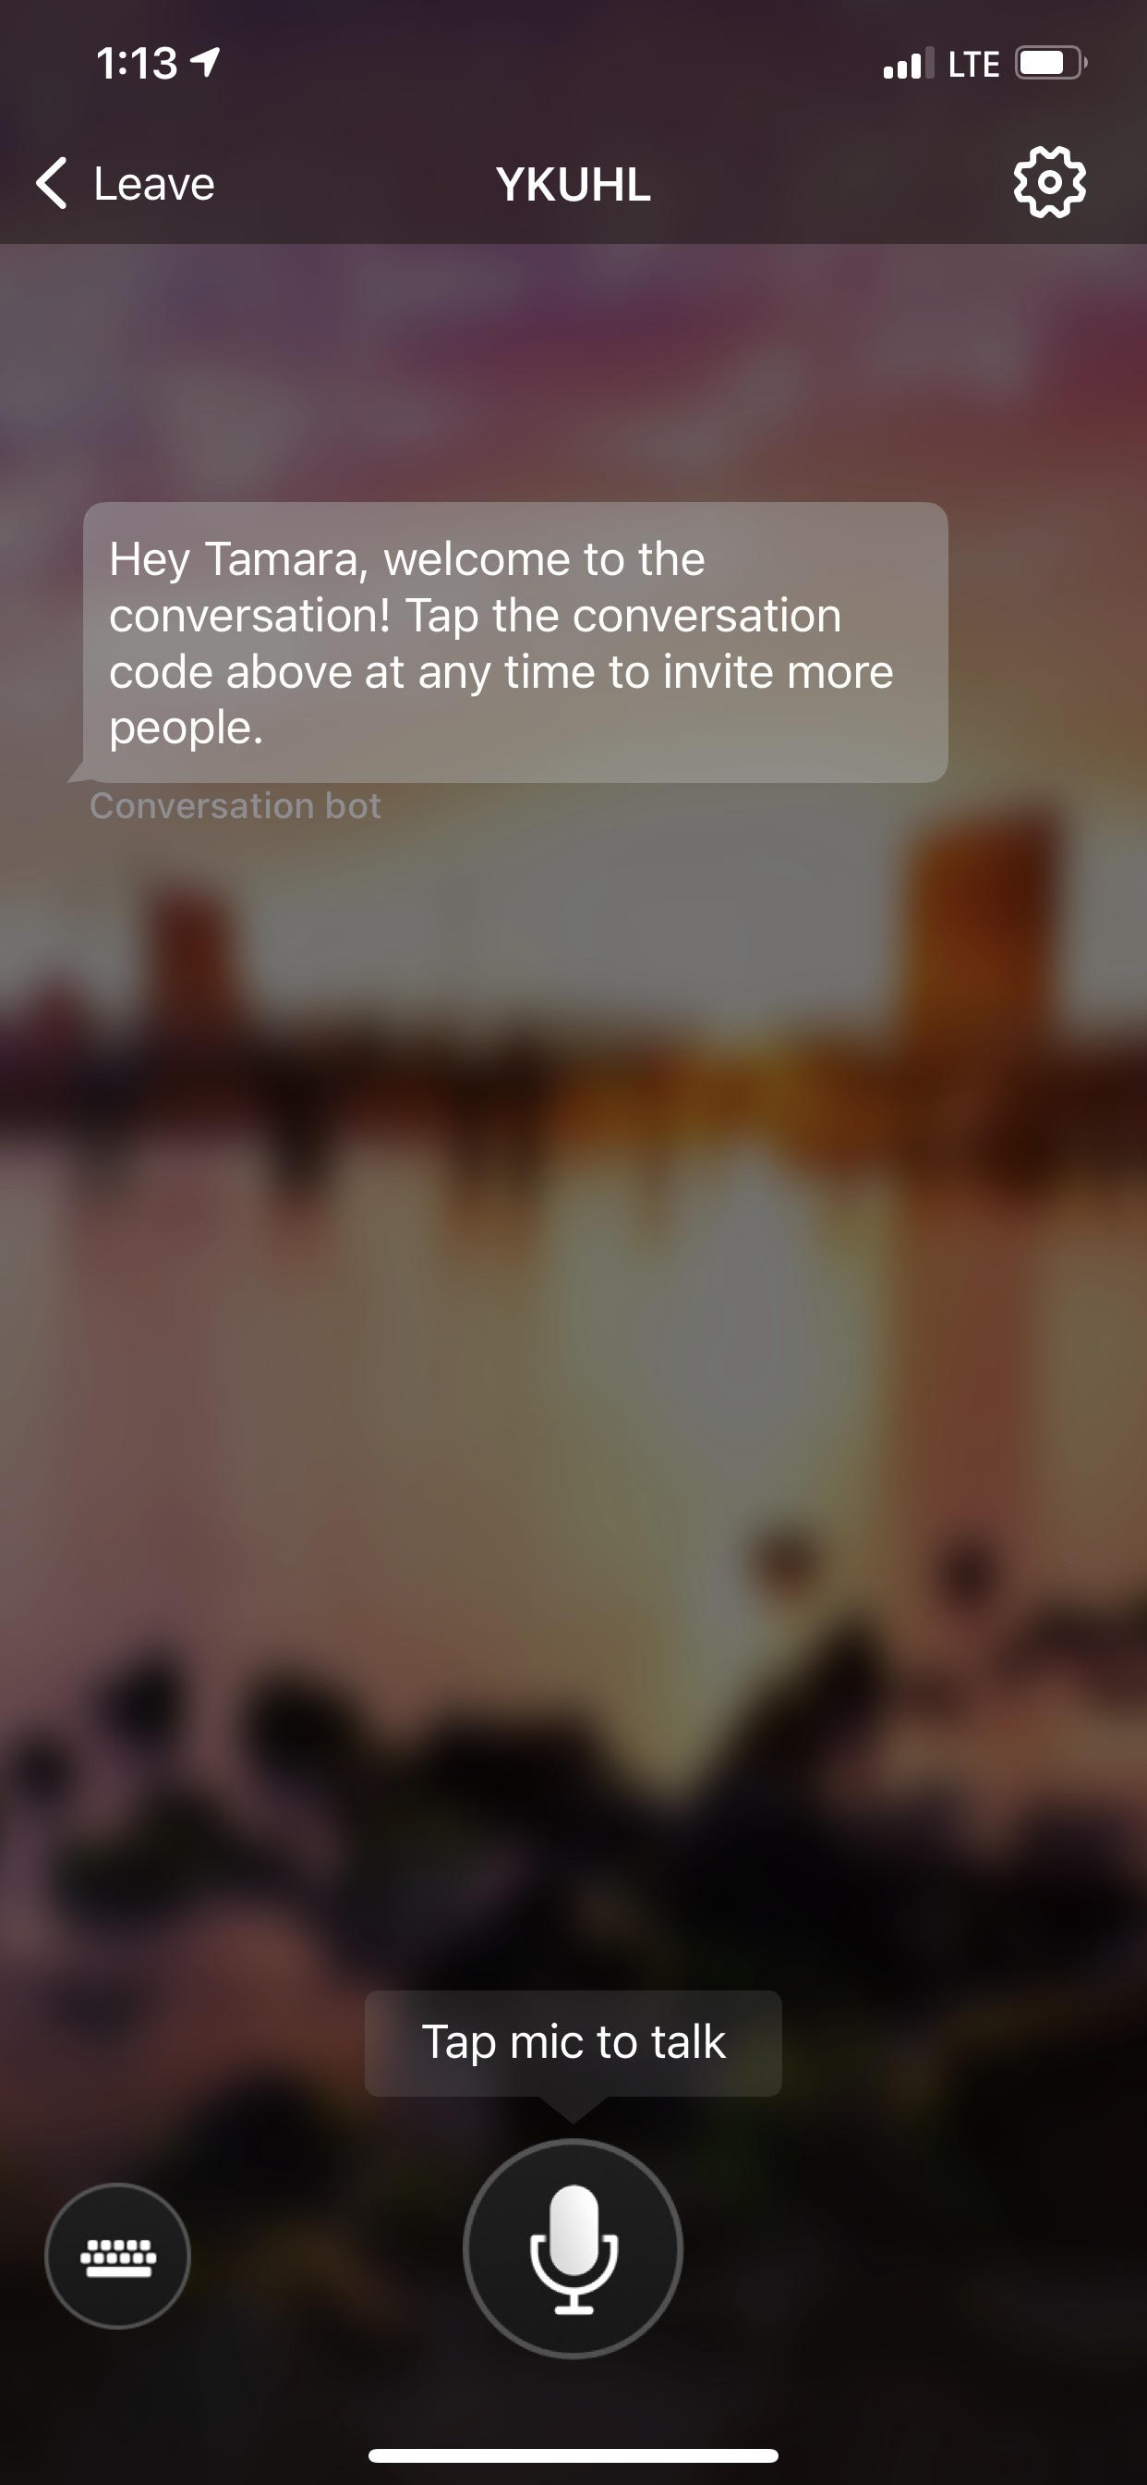
Visual Instructions

Slide 13
Provide Feedback through Padlet
Place your Group’s Acronym After Input Statement
Provide After School Tutoring - DELAC
https://padlet.com/jschriver/hggighhrcatyanuw

Slide 14
Annual Notification
Sent home within the first 15 days of school with your
Students' Score Report

Slide 15
ELPAC English Language Proficiency Assessments of California
https://prod.spotlight-education.com/frontend/portal/portal/ztRZR7de6Eju
Notes:
Use my phone – click on the link, (at the same time click the link on the slide), turn up the volume, set it by my camera. This way the video will be translated as parents are watching the video on their screen.

Slide 16
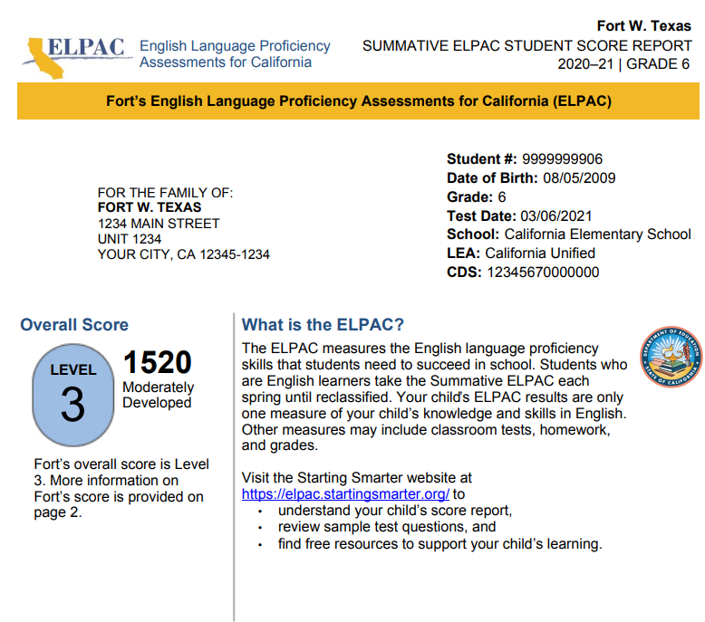
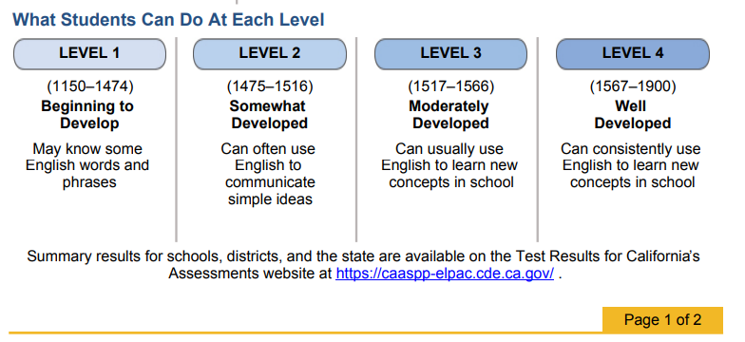
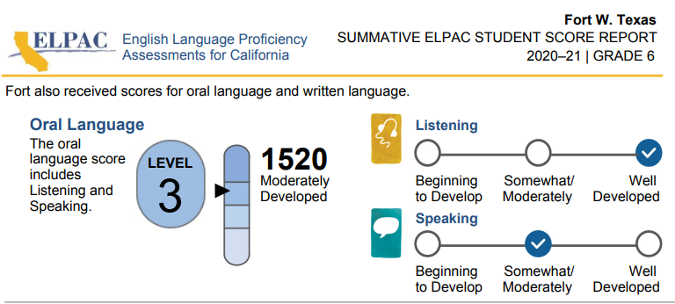
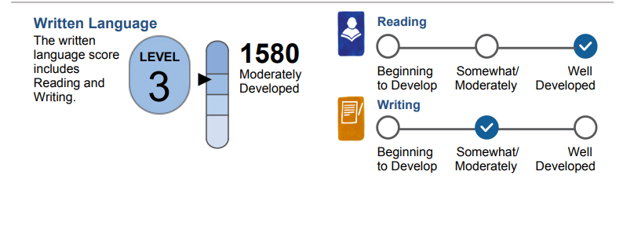

Slide 17
Our goal for all of your children!
Reclassification
RFEP = Redesignated Fluent English Proficient
Our reclassified students outperform our English Only students!

Slide 18
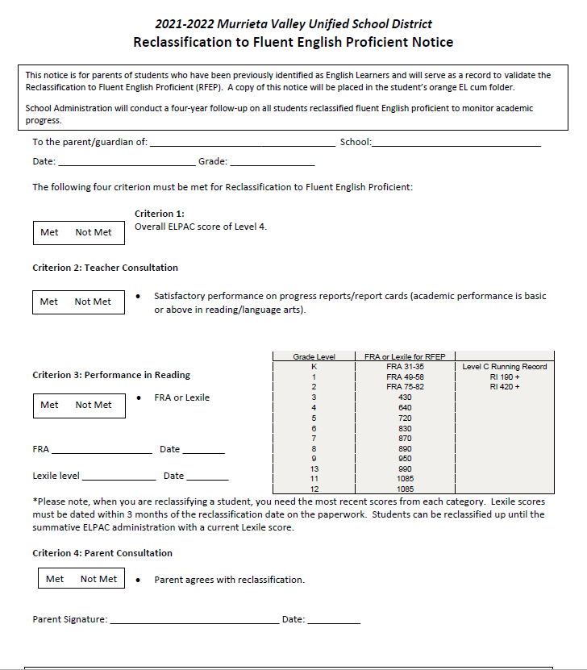
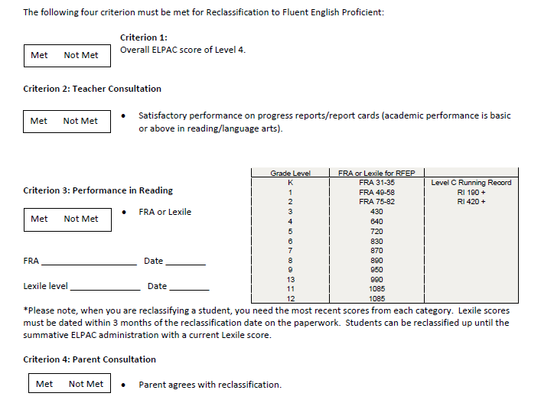

Slide 19
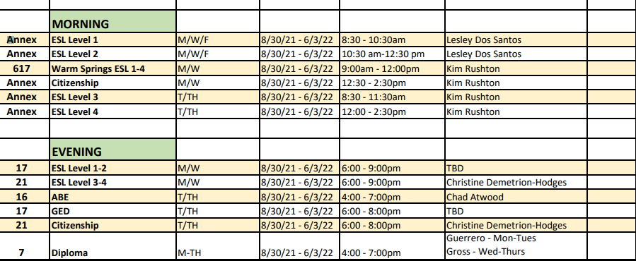
What's Coming
Looking for English Learner's Parent Leadership
English Learner Homework Support
ESL Classes @ Murrieta Canyon Academy
951-696-3905
24150 Hayes Ave. Murrieta
Next Meeting:
November 17, 2021

Slide 20
Questions
We are here for you!
Notes:
When the ppt ends, the translation services will end and the survey will pop up. We will stay in zoom to support you!

Slide 21
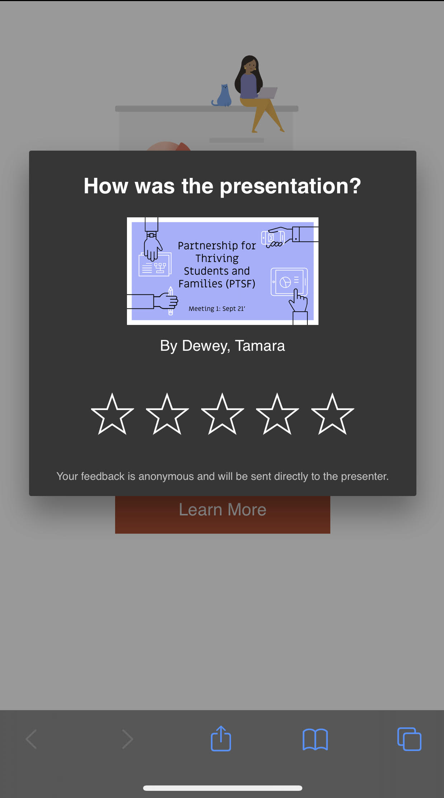
¿Cómo fue la presentación?
演示文稿如何？
Paano naging pagtatanghal ang presentation?
Bài thuyết trình thế nào?
كيف كان العرض؟
Notes:
**At the end of the presentation the suers will get two brief surveys. This is to let them know what each question is saying.
How was the presentation

Slide 22
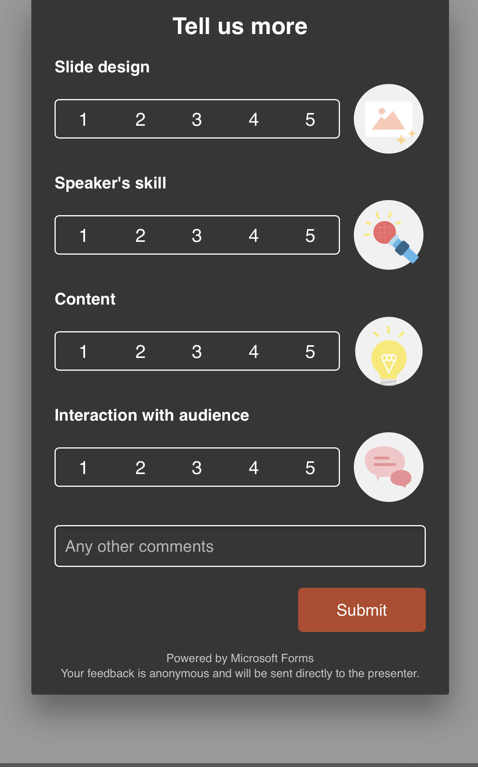
Diseño de diapositivas
幻灯片设计
Slide Disenyo
Thiết kế Trang chiếu
تصميم الشرائح
Habilidad del orador
演讲者技能
Kakayahan ng Tagapagsalita
Khả năng của diễn giả
مهارة المتحدث
Contenido
内容
Nilalaman
Nội dung
محتوى
Interacción con la audiencia
与受众的互动
Pakikipag-ugnayan sa mga Manonood
Tương tác với khán giả
التفاعل مع الجمهور

Slide 23
Microsoft Translator
Over 60 language options
Free App
Can be used on phone, tablet or desktop device
Notes:
Scott Palmer has monthly meetings with Microsoft reps so we welcome all feedback on app and how it is working for staff, students and parents

Slide 24
Thank you!
WE VALUE YOU!

